Slide 1

EXPERIMENT
Aim of Experiment: To blink the LED using Arduino Microcontroller

Slide 2
What is a LED?
A Light Emitting Diode (LED) is a semiconductor device that emits light when an electric current passes through it. LEDs are a type of solid-state lighting (SSL) technology, which means they use semiconductors to produce light, rather than heating a filament like traditional incandescent bulbs.
How Does an LED Work?
An LED consists of two types of materials, p-type (positive) and n-type (negative), which are combined to form a p-n junction. When an electric current is applied to the LED, the p-n junction is forward-biased, allowing electrons to flow from the n-type material to the p-type material. As the electrons cross the junction, they release energy in the form of photons, which is the light we see.

Slide 3
How to determine the polarity of the LED?
Leg length: the legs of the LED usually have different lengths. The longer leg is the anode (positive), while the shorter one is the cathode (negative).
Flat edge or notch: when observing the body of the LED, it is possible to notice a flat edge or a notch at the bottom. This indicator usually points to the location of the cathode.
Color identification: some LEDs have color markings on their bodies to indicate polarity. The positive leg may have a lighter color or an additional mark.

Slide 4
Applications of LEDs: -
LEDs have a wide range of applications, including:
General Lighting: LEDs are used in residential, commercial, and industrial lighting applications, such as bulbs, lamps, and ceiling lights.
Display Lighting: LEDs are used in display screens, signs, and billboards.
Automotive Lighting: LEDs are used in car headlights, taillights, and interior lighting.
Medical Lighting: LEDs are used in medical devices, such as surgical lights and diagnostic equipment.
Aviation Lighting: LEDs are used in aircraft lighting, such as landing lights and cabin lighting.
SLIDE NO. - 3

Slide 5
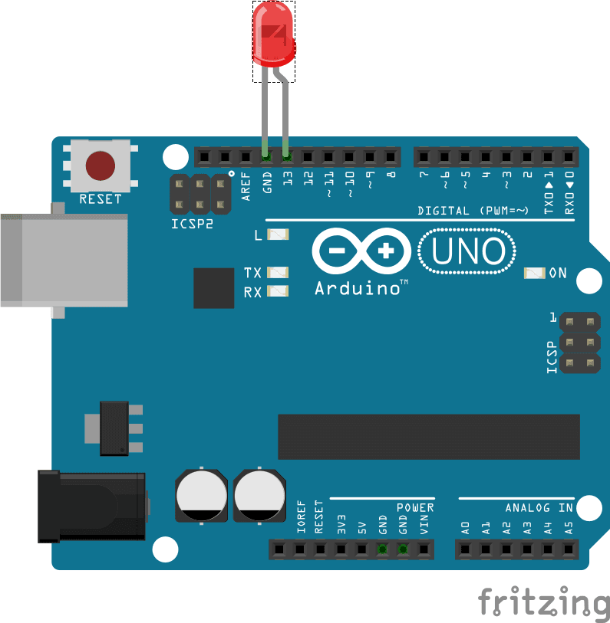
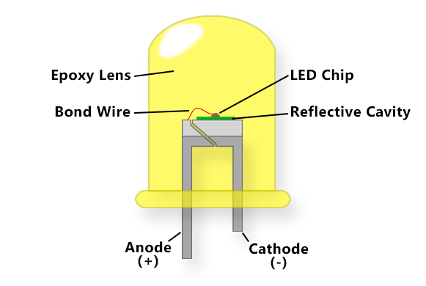
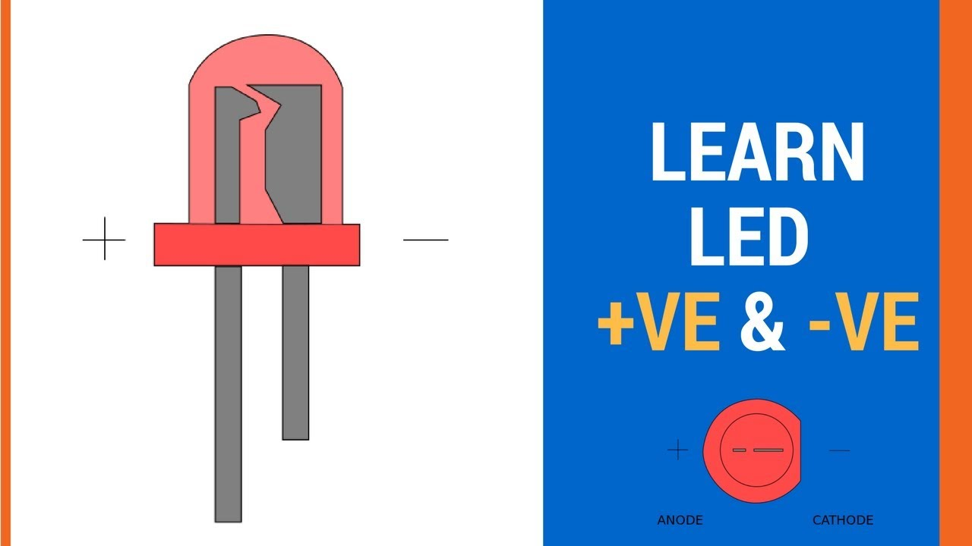
SLIDE NO. - 4

Slide 6
/*
Blink
Turns on an LED on for one second, then off for one second, repeatedly.
*/
// the setup function runs once when you press reset or power the board
void setup() { // initialize digital pin 13 as an output.
pinMode(2, OUTPUT);
}
// the loop function runs over and over again forever
void loop() {
digitalWrite(2, HIGH); // turn the LED on (HIGH is the voltage level)
delay(1000); // wait for a second
digitalWrite(2, LOW); // turn the LED off by making the voltage LOW
delay(1000); // wait for a second
}
SLIDE NO. - 5

